Slide 1
Forecast exogenous values:
Example forecast for 10 periods: 2023-04-01 is the last available point for any value.
So all variables must be forecasted for at least 2023-07-01 to 2026-01-01
But some variables don’t extend all the way to 2023-04-01. So they must be nowcasted from their last available (e.g. 2021-10-01) up to and including 2023-04-01.
Example: The last available Import data reaches until 2023-04-01
Now we check, whether Import is only determined by exogenous values or is also determined by other variables. In this case, Import is informed by: GCapitalForm and FinConsExpHH
Now we check, whether those two variables are fully available until 2023-07-01 to use their information to nowcast Import
Check line 77
(some type of) AR models

Slide 2
Forecast exogenous values
Nowcast
Check across all data what the final observation is (in processed_input_data)
Check for which dependent variables we then need to nowcast and for which time frame (cur_target_dates)
If estimated: get independent variables
Check whether any of the independent variables need to be replaced by forecasted exogenous values
Set-up nowcast
Nowcast using predict.isat
If identity:
check where identity is NA but the elements of the NA are available (i.e. where the co-variates are available)
Check where exogenous co-variates themselves are not available – we can get them from the exogenous forecasts
Predict future values (isat)
Estimated
Central
Uncertainty
Identity

Slide 3
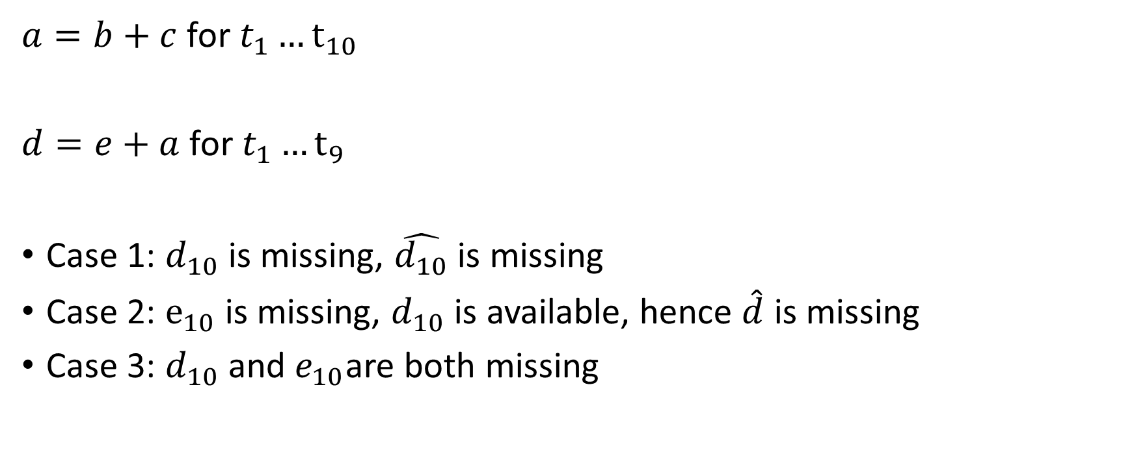
Nowcasting
$a=b+c$ for $t_{1}…t_{10}$
$d=e+a$ for $t_{1}…t_{9}$
Case 1: $d_{10}$ is missing, $\hat{d_{10}}$ is missing
Case 2: $e_{10}$ is missing, $d_{10}$ is available, hence $\hat{d}$ is missing
Case 3: $d_{10}$ and $e_{10}$are both missing

